Slide 1

Cloud Workstation
Integrated Workspace Environments

Slide 2
Precedent Study / Problem Statement
The number of people who work from home has increased by 140% since 2005
No physical separation between work and leisure time (lack of distinction)
Brainstorming is the most challenging type of meeting when it comes to remote work
Security risks and data leaks are a greater threat now that CPUs/users are away from the office space
Notes:
References: https://www.smallbizgenius.net/by-the-numbers/remote-work-statistics/#gref

Slide 3


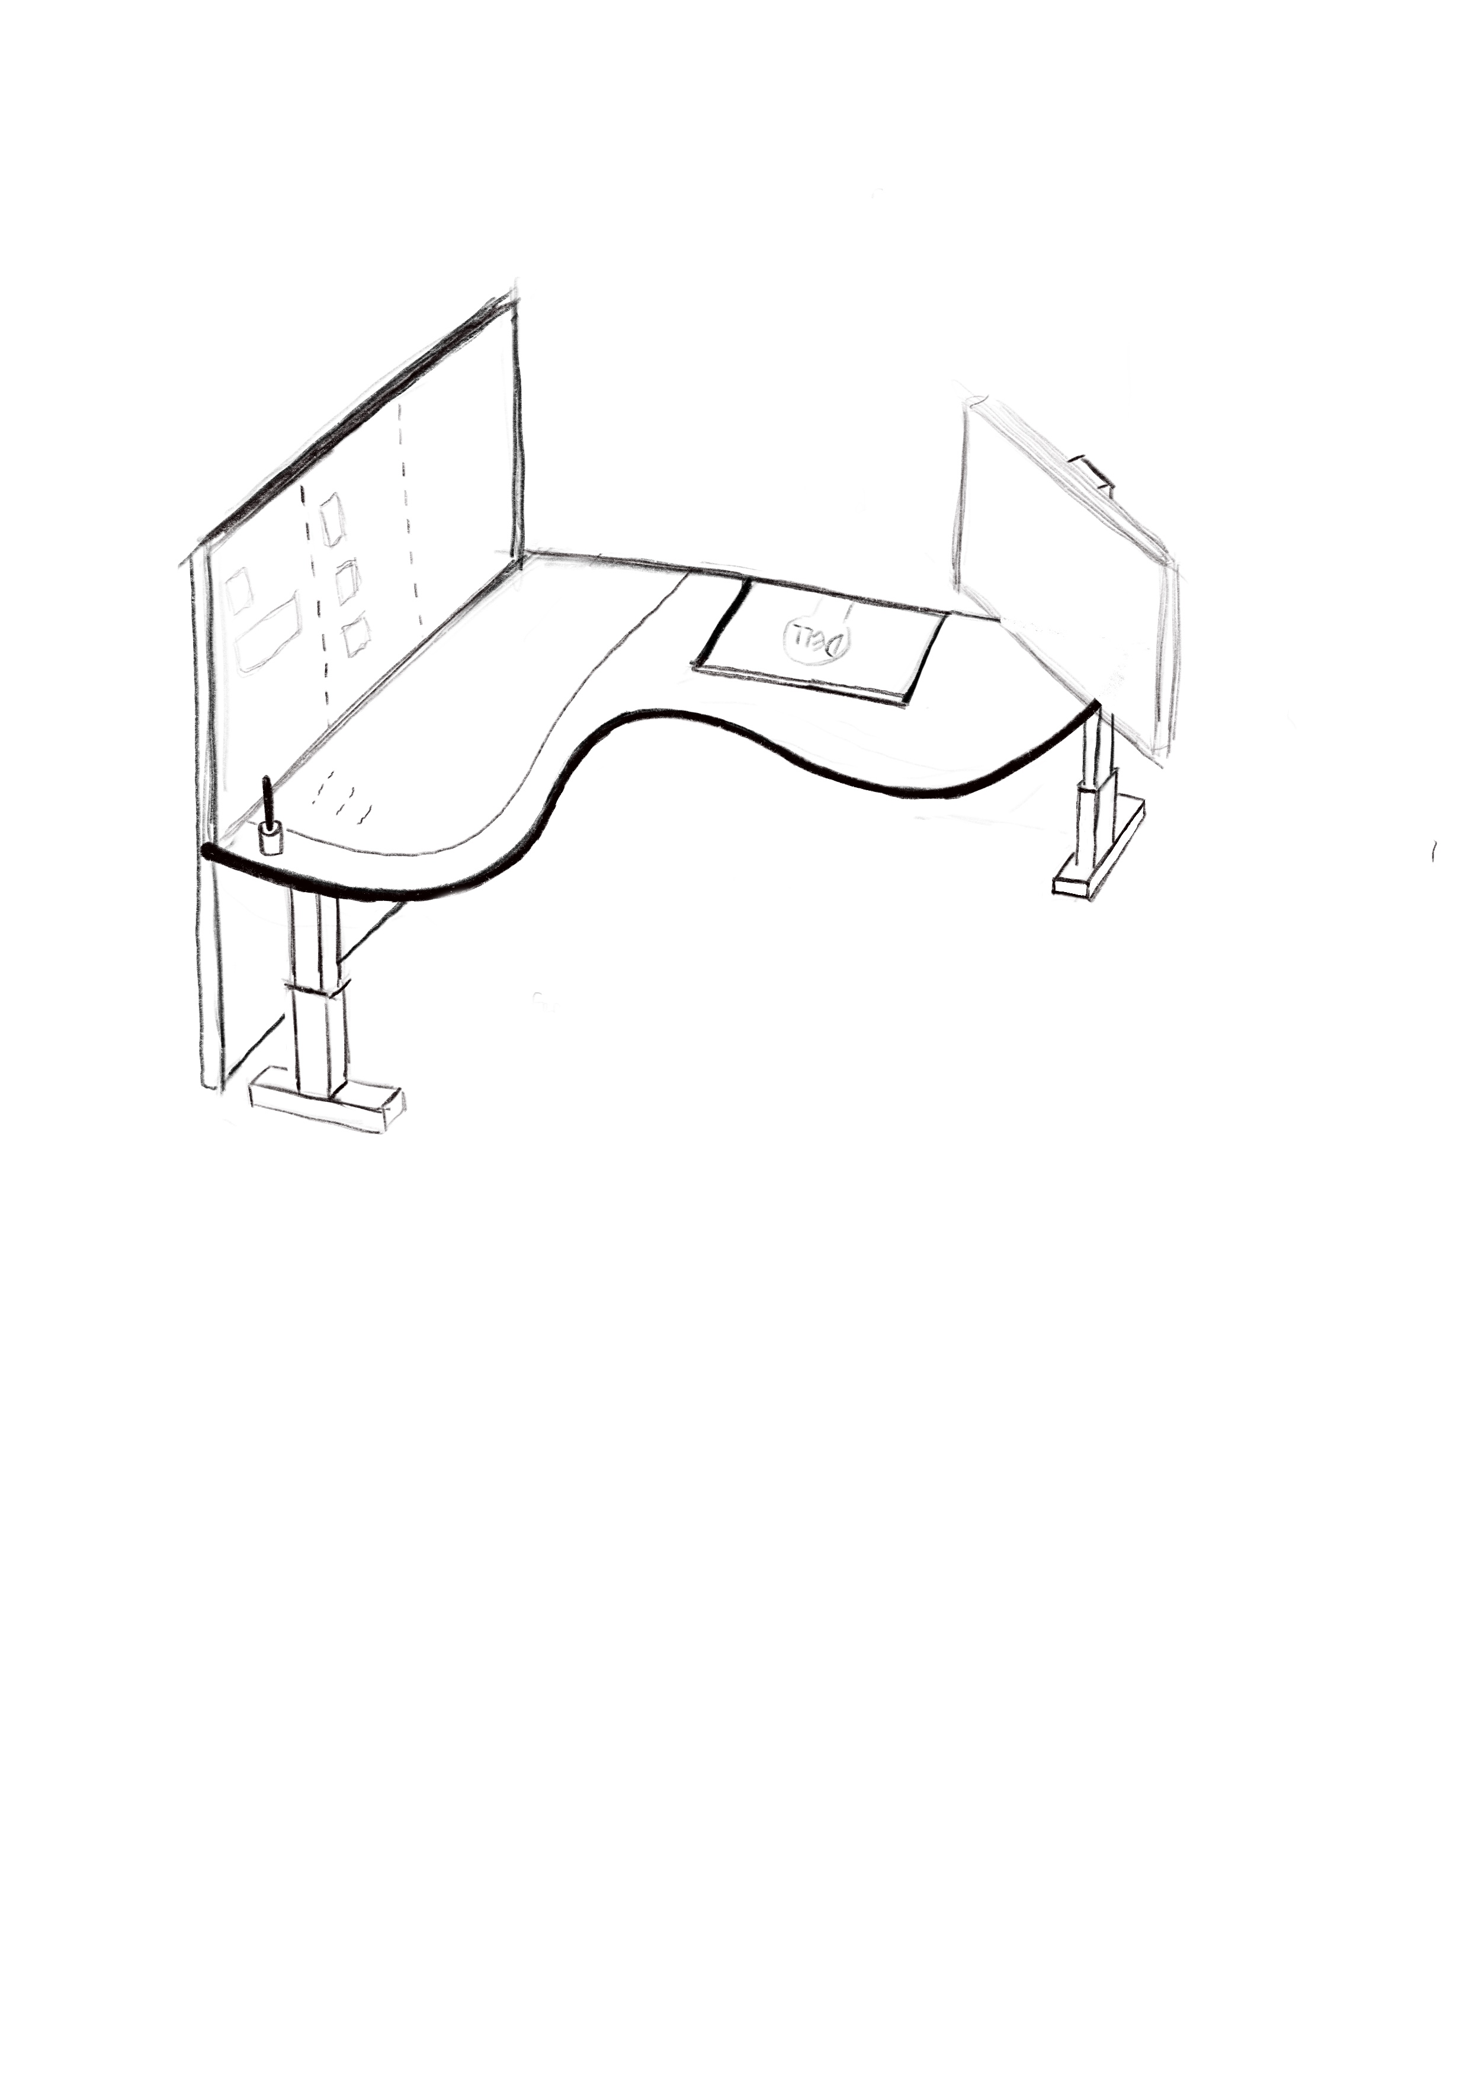
Solution
HOME
Office
User detection system to allow for only one workstation use at any point in time, automatic lock when idle (increased security)
Mirroring of office and home workstation environment to maximize productivity, utilizing cloud connected devices
Simulate a proper working environment within home to separate work and leisure time (clearer distinction)
Enhanced communication devices for more fruitful meetings
Notes:
Whether you’re working from home or in the office, the workstation (desktop/tabletop) will be of the same conditions.
Even the computer will be running on the cloud server, allowing for seamless continuation of work progress, without the difficulty of needing to ‘set up’ the workspace every time you’re shifting from office to home.
Integrated ‘cloud Kanban board’ will show the tasks on the screen/board, controlled by a stylus pen or keyboard, and will be reflective on both the cloud table in the office as well as at home.
Team members working on the same tasks will also be able to see changes on the board in real-time
Security will also be addressed, given that the devices are linked on the cloud, and hence, more could be done such as connecting the devices to user’s mobile device to alert on any changes/unauthorized use of workstation (some other future possible developments)

Slide 4

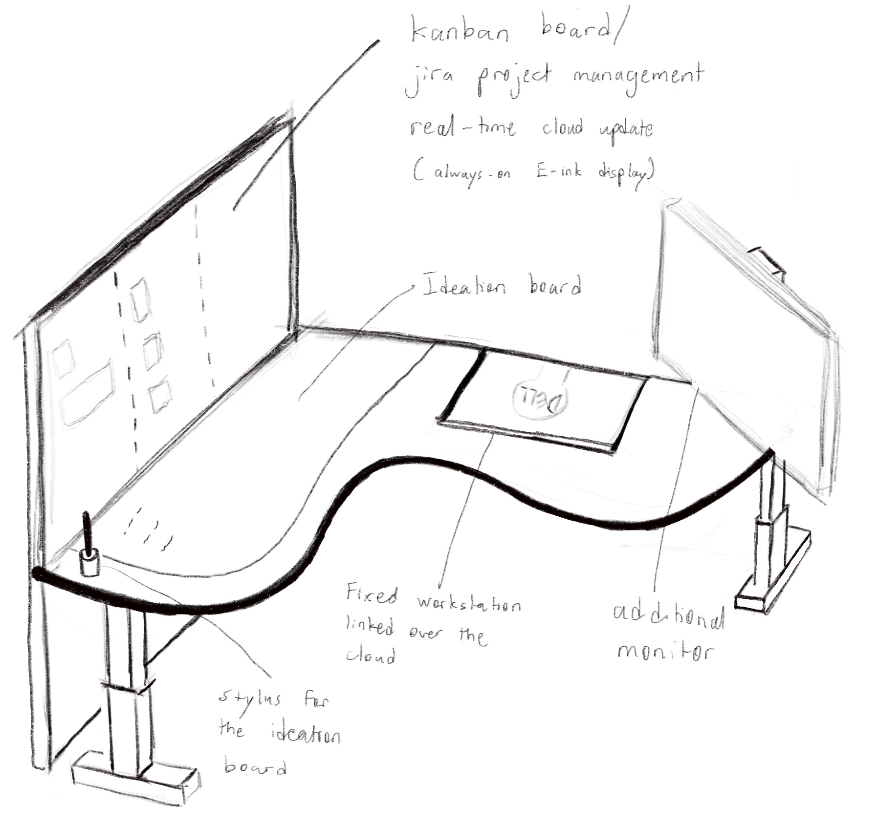
Product Key Features
Cloud connected devices include:
PC
Kanban Board (E-ink always-on display)
Ideation Board (with stylus)
Enhanced communication devices (built in HD camera for meetings)
User detection leveraging on computer vision for greater security
Desk height and monitor position memory (cloud sync across home and office workstations)
Multiple monitors
1 for Office use
1 for Home use
Notes:
References and case studies:
Omnidesk
Jira Project Management
https://www.electronicdesign.com/technologies/embedded-revolution/article/21805149/11-myths-about-epaper-displays

Slide 5
Future Developments
Improving meetings and discussions
Sound barrier
Use of VR headset
Employ the use of 5G communication networks for VR and XR
Utilizing VR capture methods such as 360 video and photo capture leveraging on the Cloud Workstation space/environment
A more modular approach for home-use cloud workstations
Especially for Kanban board which may not be able to fit in to all houses
Notes:
References:
https://qz.com/work/1707685/how-5g-will-transform-our-ability-to-work-from-home/
https://www.viar360.com/types-of-virtual-reality-capture-methods-that-allow-you-to-replicate-the-real-world/https://thenextweb.com/plugged/2016/09/22/noise-blocking-device/

